Slide 1


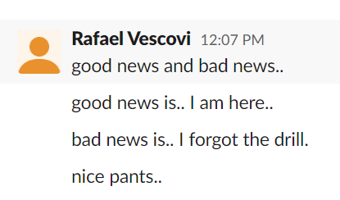
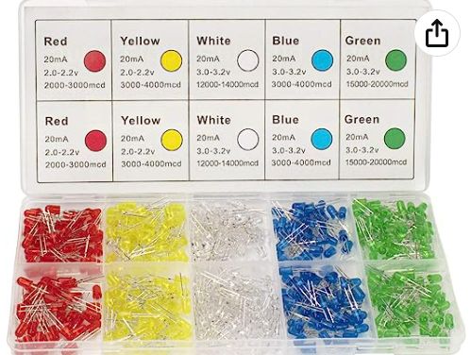

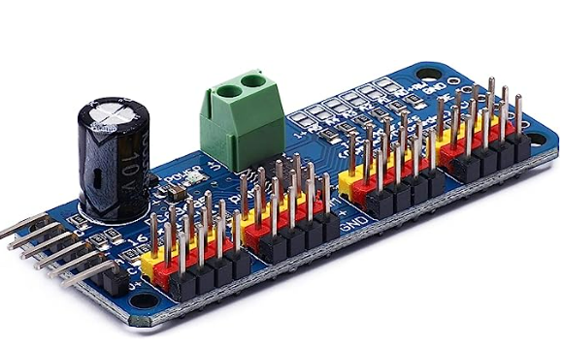
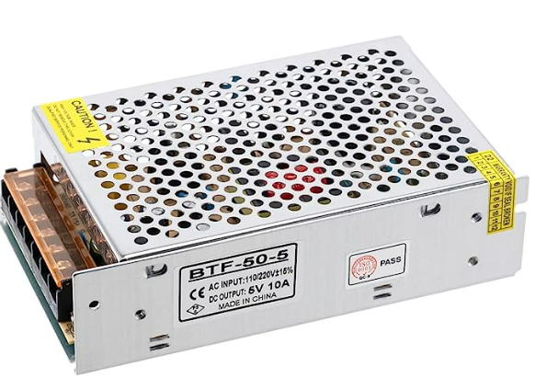
Aileen Cleary – 07/20/2023
Overall Goal: 1) Create an autonomous liquid refill system for Color Picker and 2) Write a program that dynamically visualizes (Color Picker’s) YAML files and experiment logs.
Weekly Goal: Build Barty.
Progress:
Updated 3D model of Barty with accurate hole location/size.
Measured and marked hole locations for drilling.
Began 3D printing parts for Barty.
Began ordering parts for Barty.
Challenges:
Difficulty 3D printing parts.
Major changes in design for frame/holder.
Raf forgot the drill.
Raf forgot to charge the drill.
Questionable drilling methods.
Next Steps:
Continue purchasing parts.
Update 3D model and sketch to match revisions.
Put frame together.
Drill holes for Barty.
LEDS?
Start building Barty (fingers crossed).

